Slide 1
Image Processing CSE4019
Media Player Controller Using Hand Gestures
Priyansh Chauhan 20BCE1374
Aman Mishra 20BCE1662
Kumar Vigyat 20BCE1760
Review-3

Slide 2
01
INTROdUCTION
03
TOOLS
02
OBJECTIVE
04
TABLE OF CONTENTS
CODE
03
BLOCK DIAGRAM
05
OUTPUT
04
METHODOLOGY
06
REFERENCES

Slide 3
Brief Introduction
Gesture recognition provides real-time information on a computer to enable it to fulfill user instructions. Normally, communication between a computer and a person is done through a keyboard and a mouse. To make this interaction easier and simpler without the use of additional devices such as the keyboard and mouse, we suggest building interactive gesture- based media player controls. This gesture- based interaction controls those media player activities with a webcam. We will be accomplishing this by processing Images and Pyautogui.

Slide 4
Objective
Main objective of the system we are creating is to control our media players like spotify and vlc without using input devices like keyboards and mouse. We will use image processing techniques to use hand gestures to use functions like play/pause , volume up/down and forward and backward the video or song.

Slide 5
Tools
OpenCv
Numpy
Pyautogui library( Use to bind gestures with keyboards key.)
Math
Image processing (Smoothing techniques).

Slide 6
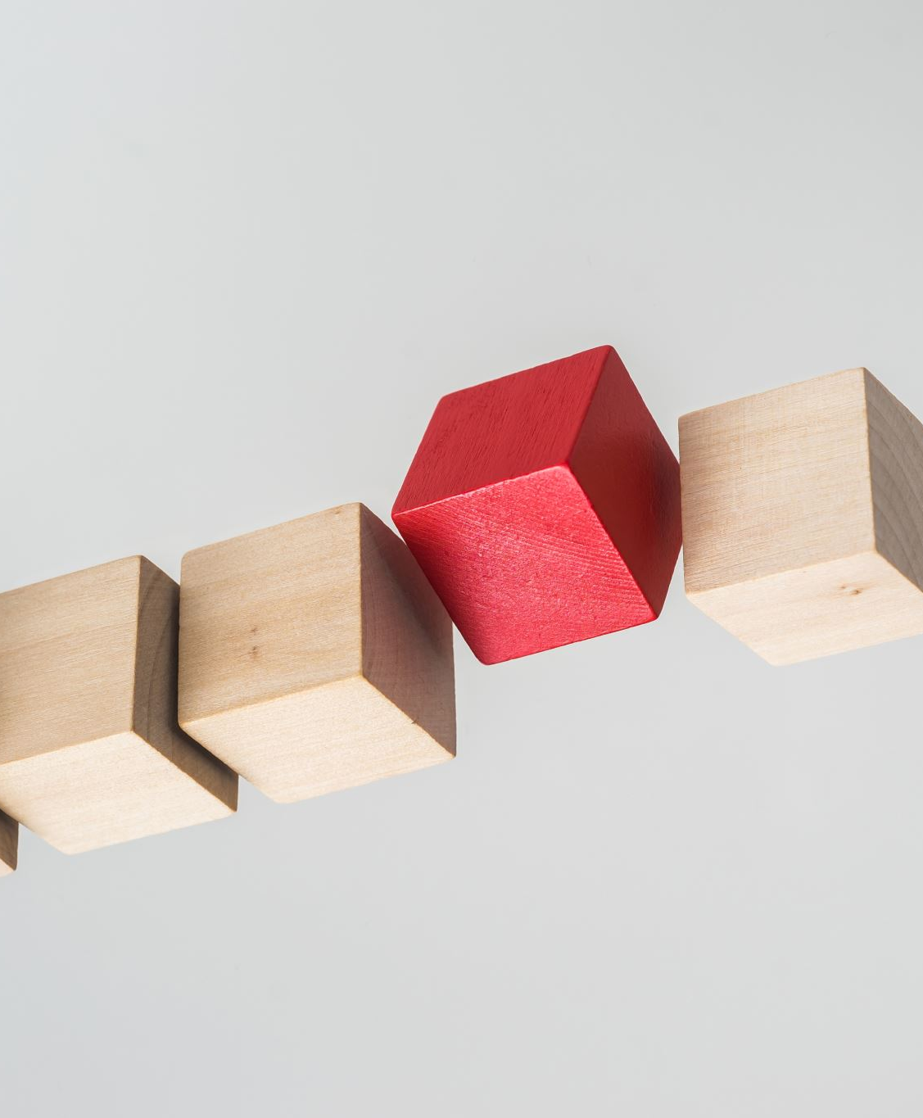
BLOCK DIAGRAM

Slide 7
BLOCK DIAGRAM
Import Libraries
&Capture Camera
Track hand on Color Basis
Convert frames into HSV
Find Contours
Invert Pixel Value and Enhance the result
Create Mask On the basis of color and filter actual color
Find Max Area Contour and draw it to live feed
Find convexity defect and apply Cosin Method
Bind Hand Gestuers With Key Board

Slide 8
mETHODOLOGY
In step-1, we import libraries of OpenCV, Numpy, Pyautogui(Pyautogui is a python library that allows mouse and keyboard control.) and capturing camera using VideoCapture Function.
In Step-2, we convert the every frame captured by the webcam to hsv(hue saturation value).
We also make a window called “color adjustment”, and create some trackbars of certain range.
In step-3, we get the values from the trackbar and pass them to array and assign to lower_bound and upper_bound variables.
In step-4,we create a mask for the hsv values of the video capture with the lower and upper bound color values range and filter using bitwise_and function.

Slide 9
methodology
In Step 5, we Invert the pixel value of the captured image or video and then improve the output by using mask and thresholding.
In Step 6, We find the contour of a particular coloured object.
In Step 7, We locate the Max area contour and draw it on the live feed.
In Step 8, we determine Convexity for Counting Values and Use the Cosine Method.
In Step 9, We will bind the hand gestures with keyboard with library pyautogui.

Slide 10
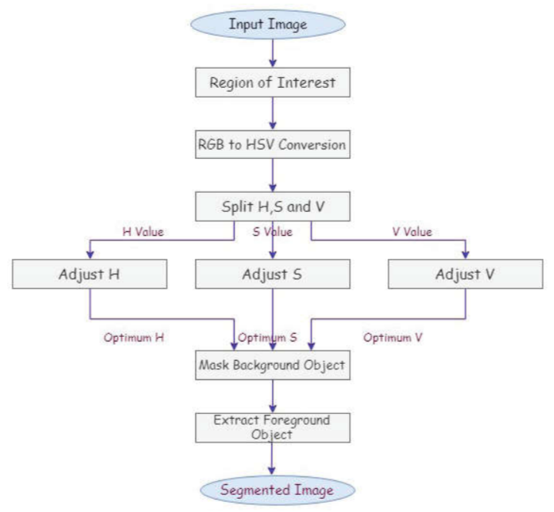
First we will take input image
Then we will split in two regions.
Then we will take that RGB image and change it to HSV image.
We will spilt H ,S ,V and try it adjust accordingly
After that we will mask the Background object of image.\
And Extract foreground object in this project that will be our hand.

Slide 11
CODE

Slide 12

import cv2
import numpy as np
import math
import pyautogui as p
import time as t
cap = cv2.VideoCapture(0, cv2.CAP_DSHOW) #for capturing camera
#the 0 detect the camera of the device if you have multiple camera u can change that value with respect to their device number.
def nothing(x):
pass
# window name
cv2.namedWindow("Color Adjustments", cv2.WINDOW_NORMAL)
cv2.resizeWindow("Color Adjustments", (300, 300))
cv2.createTrackbar("Thresh", "Color Adjustments", 0, 255, nothing)
# COlor Detection Track
cv2.createTrackbar("Lower_H", "Color Adjustments", 0, 255, nothing)
cv2.createTrackbar("Lower_S", "Color Adjustments", 0, 255, nothing)
cv2.createTrackbar("Lower_V", "Color Adjustments", 0, 255, nothing)
cv2.createTrackbar("Upper_H", "Color Adjustments", 255, 255, nothing)
cv2.createTrackbar("Upper_S", "Color Adjustments", 255, 255, nothing)
cv2.createTrackbar("Upper_V", "Color Adjustments", 255, 255, nothing)

Slide 13
while True:
_, frame = cap.read()
frame = cv2.flip(frame, 2)
frame = cv2.resize(frame, (600, 500))
# Get hand data from the rectangle sub window
cv2.rectangle(frame, (0, 1), (300, 500), (255, 0, 0), 0)
crop_image = frame[1:500, 0:300]
# Step -2
hsv = cv2.cvtColor(crop_image, cv2.COLOR_BGR2HSV)
# detecting hand
l_h = cv2.getTrackbarPos("Lower_H", "Color Adjustments")
l_s = cv2.getTrackbarPos("Lower_S", "Color Adjustments")
l_v = cv2.getTrackbarPos("Lower_V", "Color Adjustments")
u_h = cv2.getTrackbarPos("Upper_H", "Color Adjustments")
u_s = cv2.getTrackbarPos("Upper_S", "Color Adjustments")
u_v = cv2.getTrackbarPos("Upper_V", "Color Adjustments")
# Step -3
lower_bound = np.array([l_h, l_s, l_v])
upper_bound = np.array([u_h, u_s, u_v])

Slide 14
# Step - 4
mask = cv2.inRange(hsv, lower_bound, upper_bound) # Creating Mask
filtr = cv2.bitwise_and(crop_image, crop_image, mask=mask)
# filter mask with image
filtr = cv2.bitwise_and(crop_image, crop_image, mask=mask)
#Step - 5
mask1 = cv2.bitwise_not(mask)
m_g = cv2.getTrackbarPos("Thresh", "Color Adjustments") #getting track bar value
ret,thresh = cv2.threshold(mask1,m_g,255,cv2.THRESH_BINARY)
dilata = cv2.dilate(thresh,(3,3),iterations = 6)
#Step -6
#findcontour(img,contour_retrival_mode,method)
cnts,hier = cv2.findContours(thresh,cv2.RETR_TREE,cv2.CHAIN_APPROX_SIMPLE)
try:
#print("try")
#Step -7
# Find contour with maximum area
cm = max(cnts, key=lambda x: cv2.contourArea(x))
#print("C==",cnts)
epsilon = 0.0005*cv2.arcLength(cm,True)

Slide 15
data= cv2.approxPolyDP(cm,epsilon,True)
hull = cv2.convexHull(cm)
cv2.drawContours(crop_image, [cm], -1, (50, 50, 150), 2)
cv2.drawContours(crop_image, [hull], -1, (0, 255, 0), 2)
#Step - 8
# Find convexity defects
hull = cv2.convexHull(cm, returnPoints=False)
defects = cv2.convexityDefects(cm, hull)
count_defects = 0
#print("Area==",cv2.contourArea(hull) - cv2.contourArea(cm))
for i in range(defects.shape[0]):
s,e,f,d = defects[i,0]
start = tuple(cm[s][0])
end = tuple(cm[e][0])
far = tuple(cm[f][0])
#Cosin Rule
a = math.sqrt((end[0] - start[0]) ** 2 + (end[1] - start[1]) ** 2)
b = math.sqrt((far[0] - start[0]) ** 2 + (far[1] - start[1]) ** 2)
c = math.sqrt((end[0] - far[0]) ** 2 + (end[1] - far[1]) ** 2)

Slide 16
angle = (math.acos((b ** 2 + c ** 2 - a ** 2) / (2 * b * c)) * 180) / 3.14
#print(angle)
# if angle <= 50 draw a circle at the far point
if angle <= 50:
count_defects += 1
cv2.circle(crop_image,far,5,[255,255,255],-1)
print("count==",count_defects)
#Step - 9
# Print number of fingers
if count_defects == 0:
cv2.putText(frame, " ", (50, 50), cv2.FONT_HERSHEY_SIMPLEX, 2,(0,0,255),2)
elif count_defects == 1:
p.press("space")
cv2.putText(frame, "Play/Pause", (50, 50), cv2.FONT_HERSHEY_SIMPLEX, 2,(0,0,255), 2)
elif count_defects == 2:
p.press("up")
cv2.putText(frame, "Volume UP", (5, 50), cv2.FONT_HERSHEY_SIMPLEX, 2,(0,0,255), 2)
elif count_defects == 3:

Slide 17
p.press("down")
cv2.putText(frame, "Volume Down", (50, 50), cv2.FONT_HERSHEY_SIMPLEX, 2,(0,0,255), 2)
elif count_defects == 4:
p.press("right")
cv2.putText(frame, "Forward", (50, 50), cv2.FONT_HERSHEY_SIMPLEX, 2,(0,0,255), 2)
else:
pass except:
pass
#step -10
cv2.imshow("Thresh", thresh)
#cv2.imshow("mask==",mask)
cv2.imshow("filter==",filtr)
cv2.imshow("Result", frame)
key = cv2.waitKey(25) &0xFF
if key == 27:
break
cap.release()
cv2.destroyAllWindows()
END OF THE CODE

Slide 18
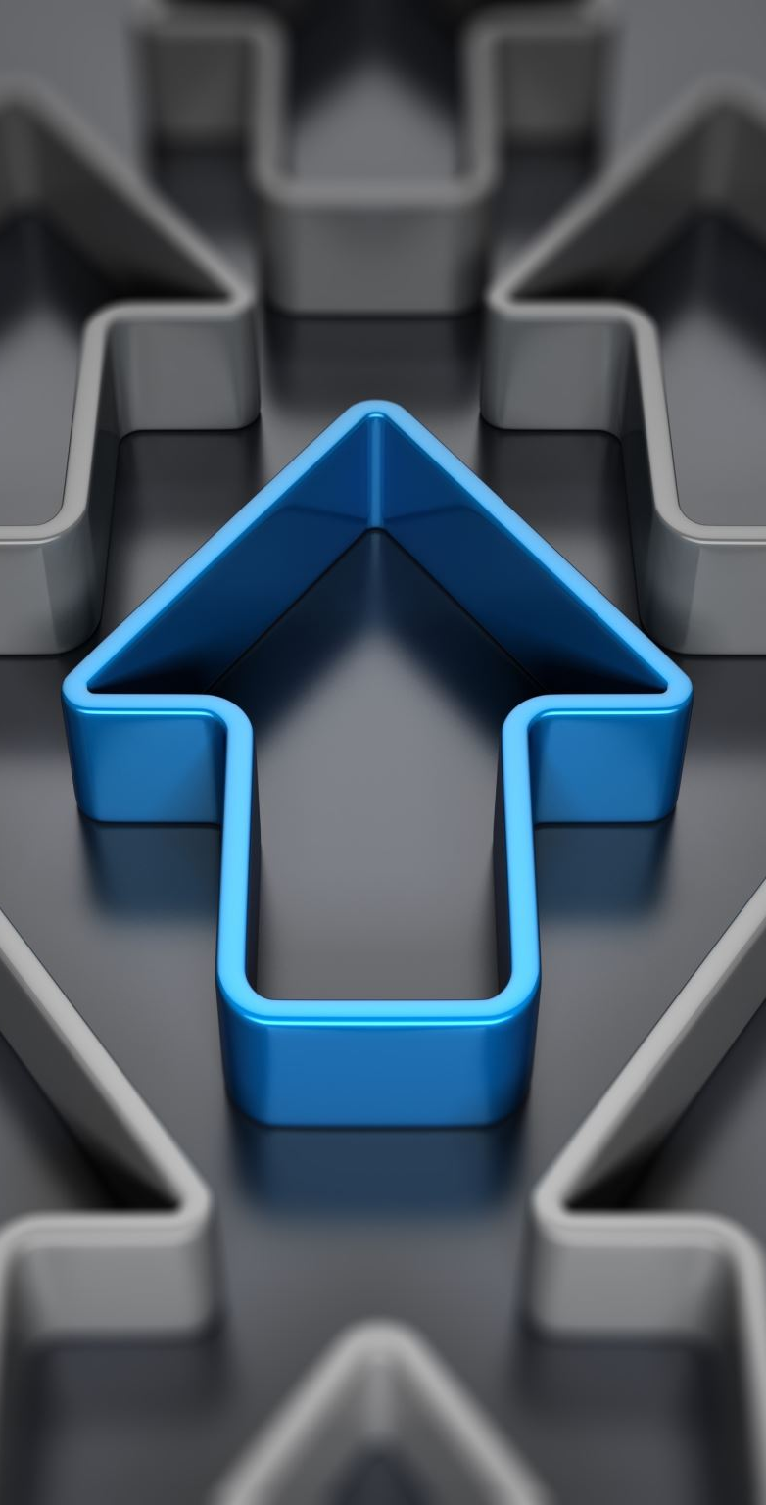
OutpUT

Slide 19
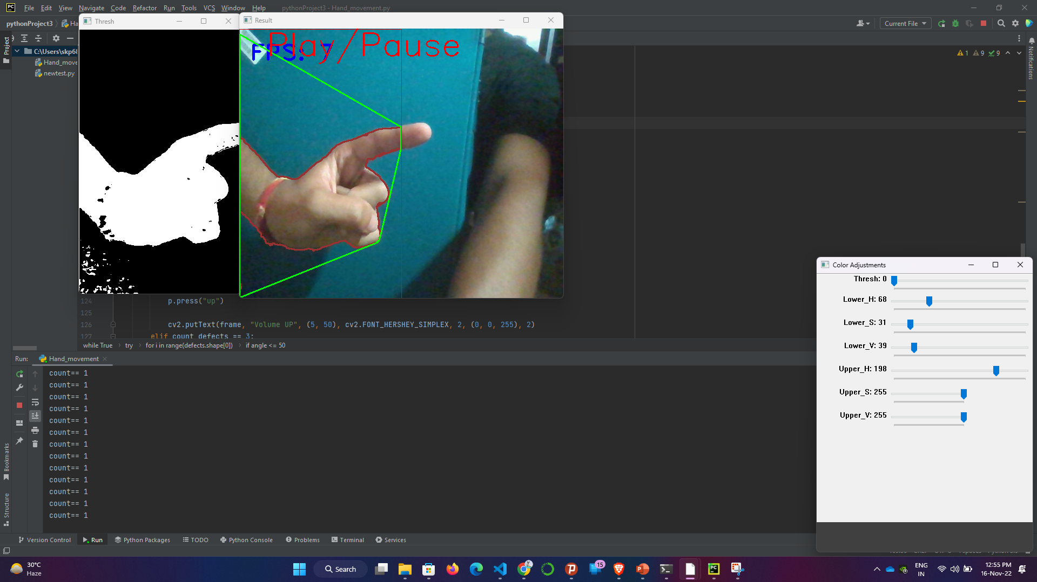
This output shows the one finger which causes volume up function

Slide 20
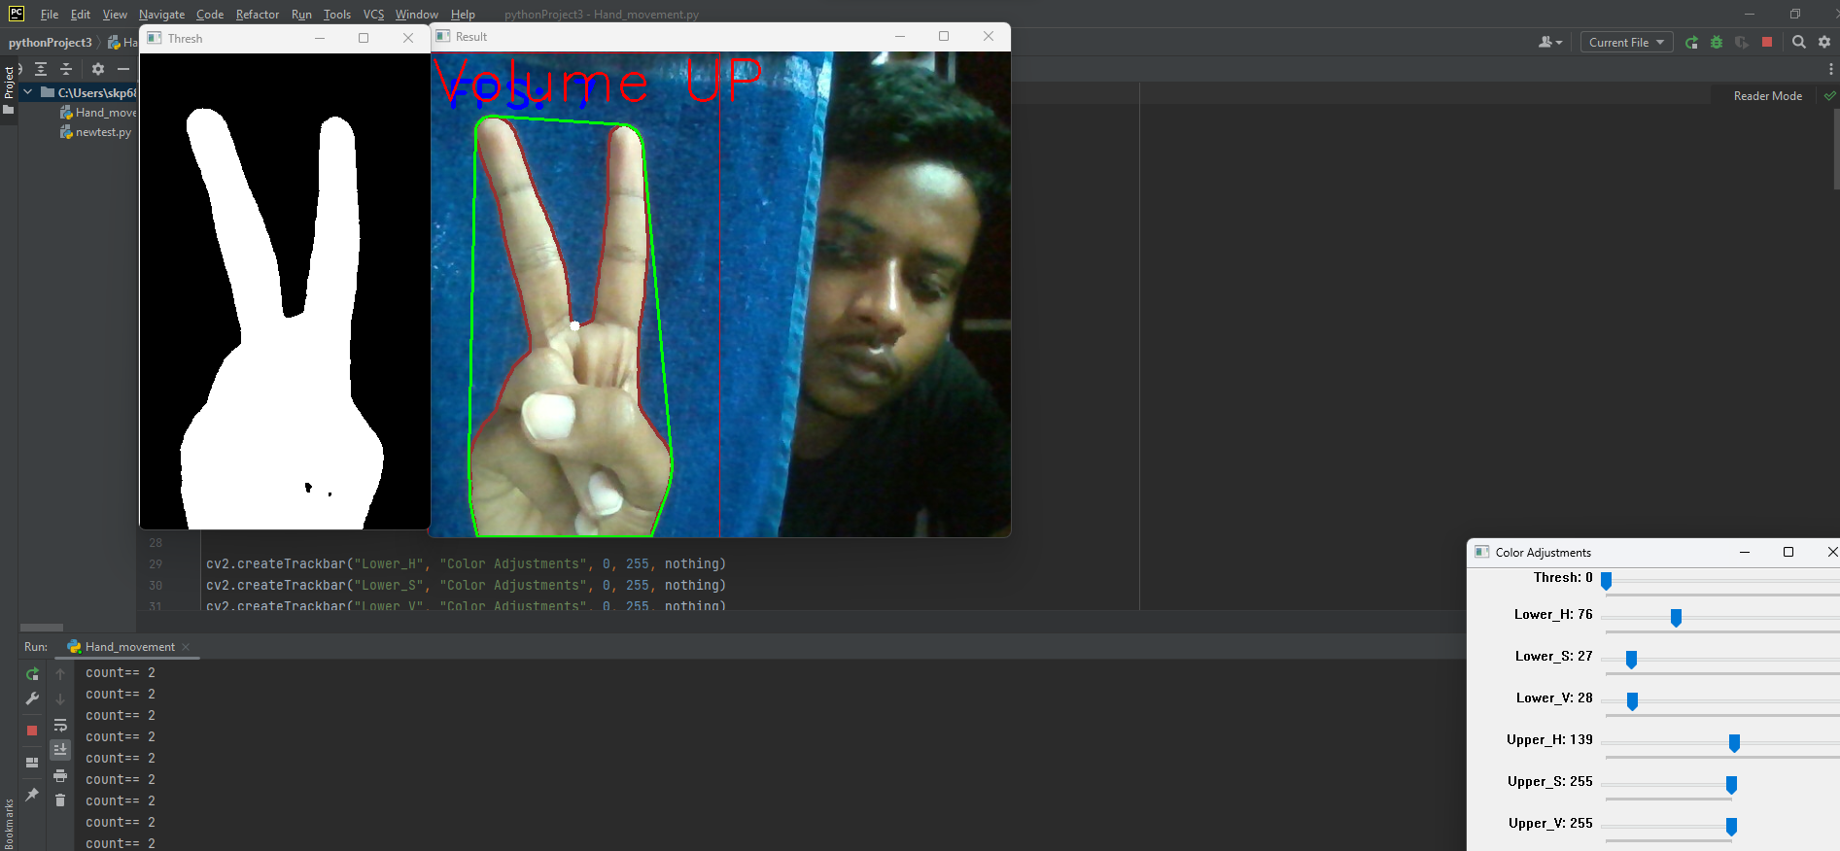
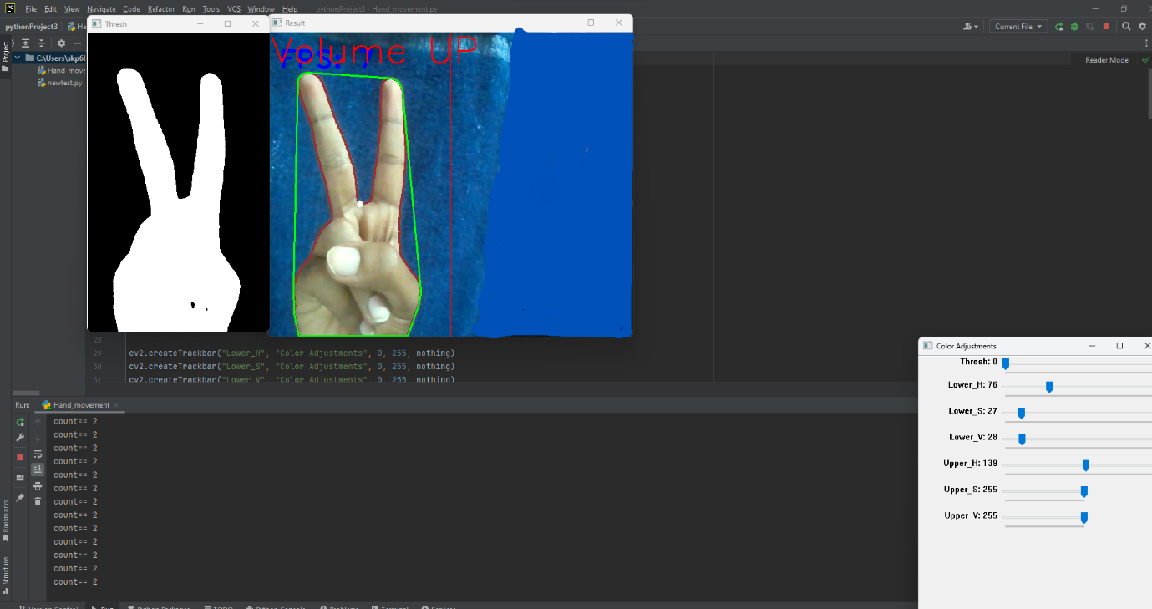
This output shows the two finger which causes volume up function

Slide 21
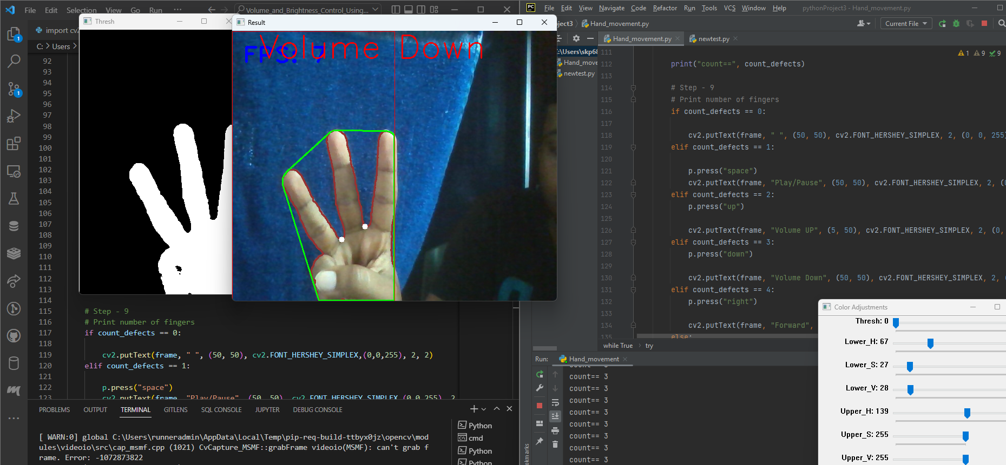
This output shows the five finger which causes volume down function

Slide 22
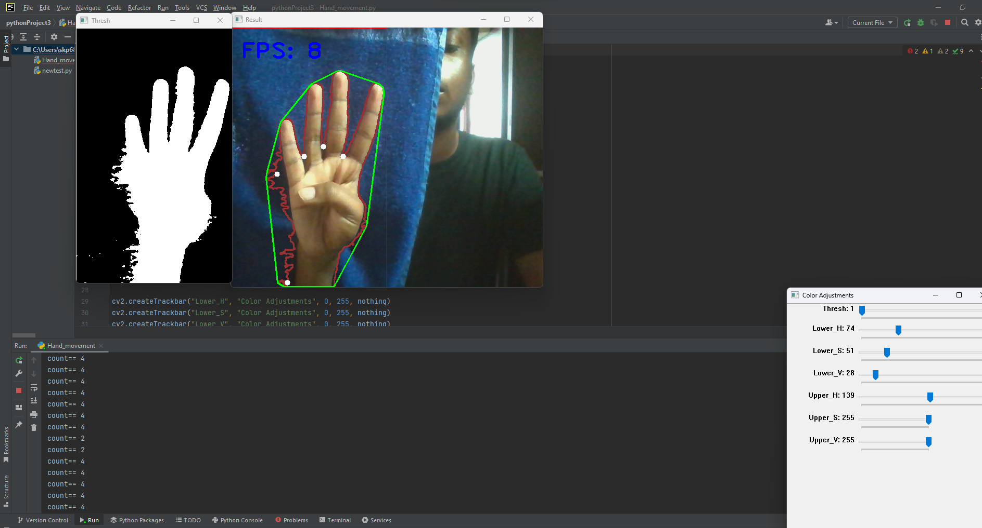
This output shows the four finger which causes forward function

Slide 23
rEFRENCES
https://cs.stanford.edu/~yifengj/files/1505_npr.pdf
https://ieeexplore.ieee.org/document/8936959
https://ijrpr.com/uploads/V3ISSUE5/IJRPR4107.pdf
V. Pavlovic, R. Sharma and T. S. Huang, “Visual Interpretation of Hand Gestures for Human-Computer Interaction: A Review,” IEEE Trans. On Pattern Analysis and Machine Intelligence, vol. 19(7), pp. 677-695,1997.

